Slide 1
Pro BoNO
Obtain some legal experience this summer
Complete your required 50 hours of pro bono for admission to the New York bar
Melinda R. Saran
Vice Dean for Social Justice Initiatives

Slide 2
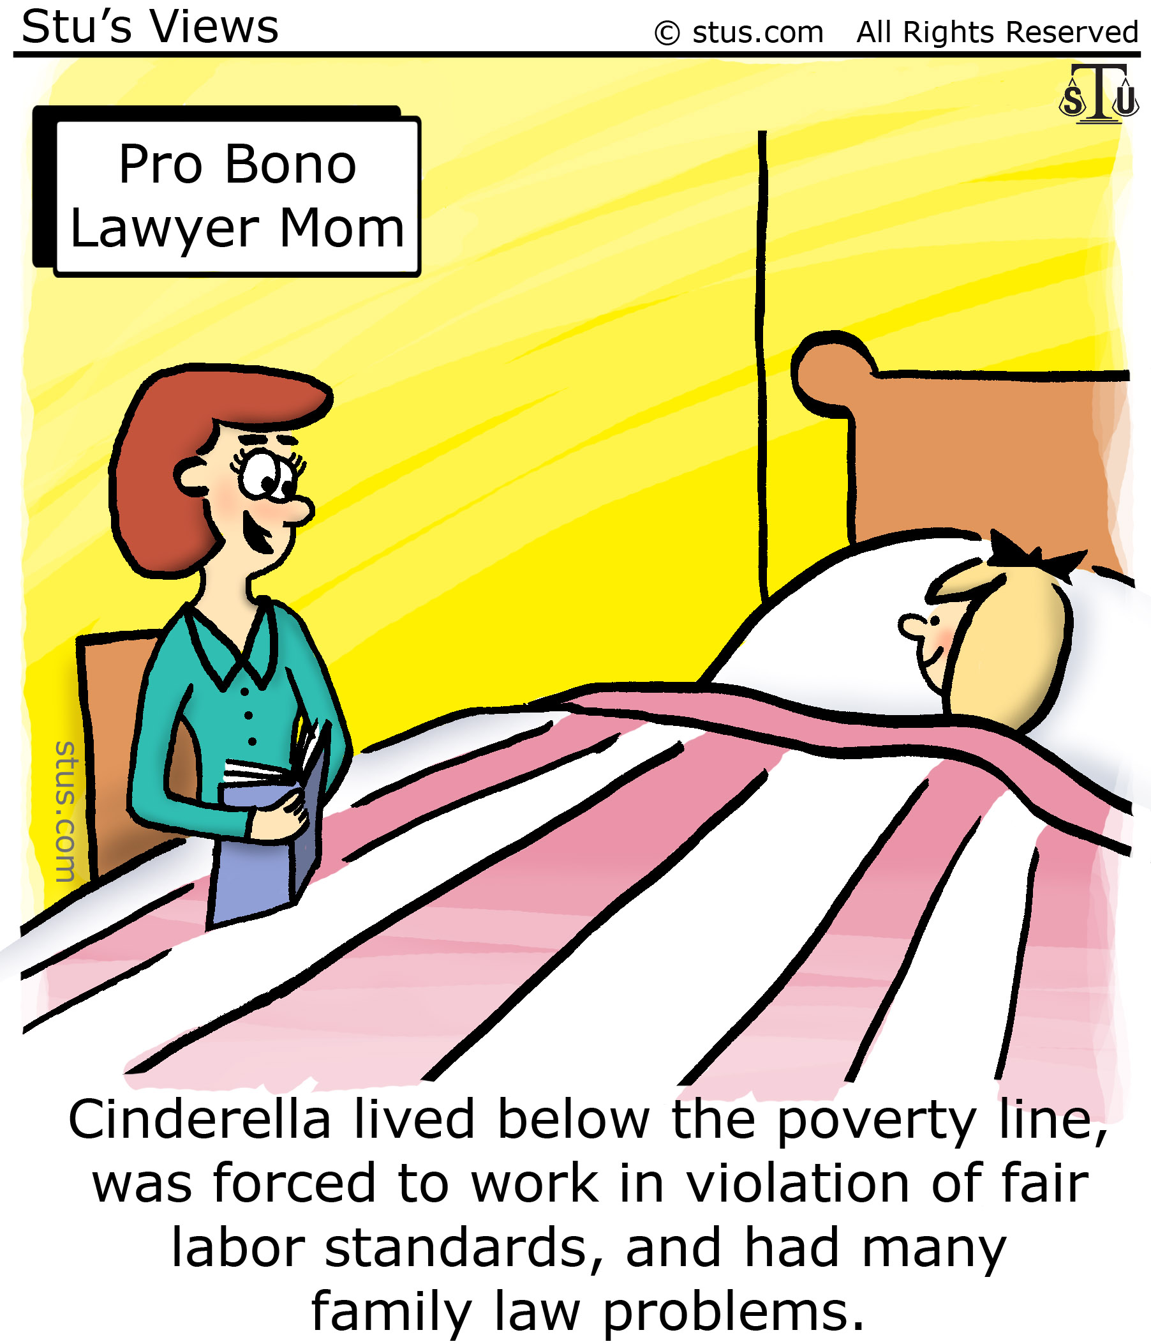

Slide 3
Pro Bono service as defined in 22 NYCRR §520.16(b):
(1) Assists in the provision of legal services without charge for
    persons of limited means;
    not-for-profit organizations
    individuals, groups or organizations seeking to secure or promote access to justice, including, but not limited to, the protection of civil rights, civil liberties or public rights;
Assists in the provision of legal assistance in public service or for a judicial, legislative, executive or other governmental entity; or
Provides legal services pursuant to subdivision two and three of section 484 of the Judiciary Law, or pursuant to equivalent legal authority in the jurisdiction where the services are performed.

Slide 4
50 Hours of Pro Bono Services for Admission to the Bar
Any applicant who has successfully graduated law school, completed the bar examination and seeks admission to practice.
START - Can begin counting the 50 hours of required pro bono service only after applicant began her/his law school education
FINISH - Can complete the 50 hours of required pro bono service up to the date of filing of your Application for Admission (after the bar examination)
CONTINUE - Can continue to do pro bono service your entire career and in retirement (attorney emeritus).

Slide 5
What qualifies as pro bono work?
(1) For credit
    Clinics - https://www.law.buffalo.edu/beyond/clinics.html
    Externships- https://www.law.buffalo.edu/beyond/externships.html
    Practica https://www.law.buffalo.edu/beyond/practica.html
(2) Not for credit
    Legal services for low income individuals
    Limited scope legal clinics
    Summer internships in government agencies (US Attorney, District Attorney, Judges)

Slide 6
Documentation of 50 Hours
Form Affidavit: https://www.nybarexam.org/Admission/50Hour_ProBonoCertification_3.4.2020.pdf
Law-related employment affidavit:
https://www.nybarexam.org/Admission/Part%20III_LawRelatedEmployment_3.4.2020.pdf

Slide 7
Summer opportunities
Paid
  Fellowships
  Grants that legal service agencies have
Volunteer
For credit
  Clinics
  Externships

Slide 8
Paid summer pro bono
UB Law fellowships (formerly BPLIP) - Fellowships - School of Law - University at Buffalo
New York State Bar Foundation Fellowships - Grants, Fellowships & Scholarships - The New York Bar Foundation: TNYBF
Other fellowships posted by CSO on LOCK
Grants Legal Service agencies have – posted by CSO on LOCK or ask

Slide 9
Volunteer Pro Bono
Local legal services agencies
Government agencies
Courts and judges
Legislators – no political work
Not-for-profit agencies doing legal work

Slide 10
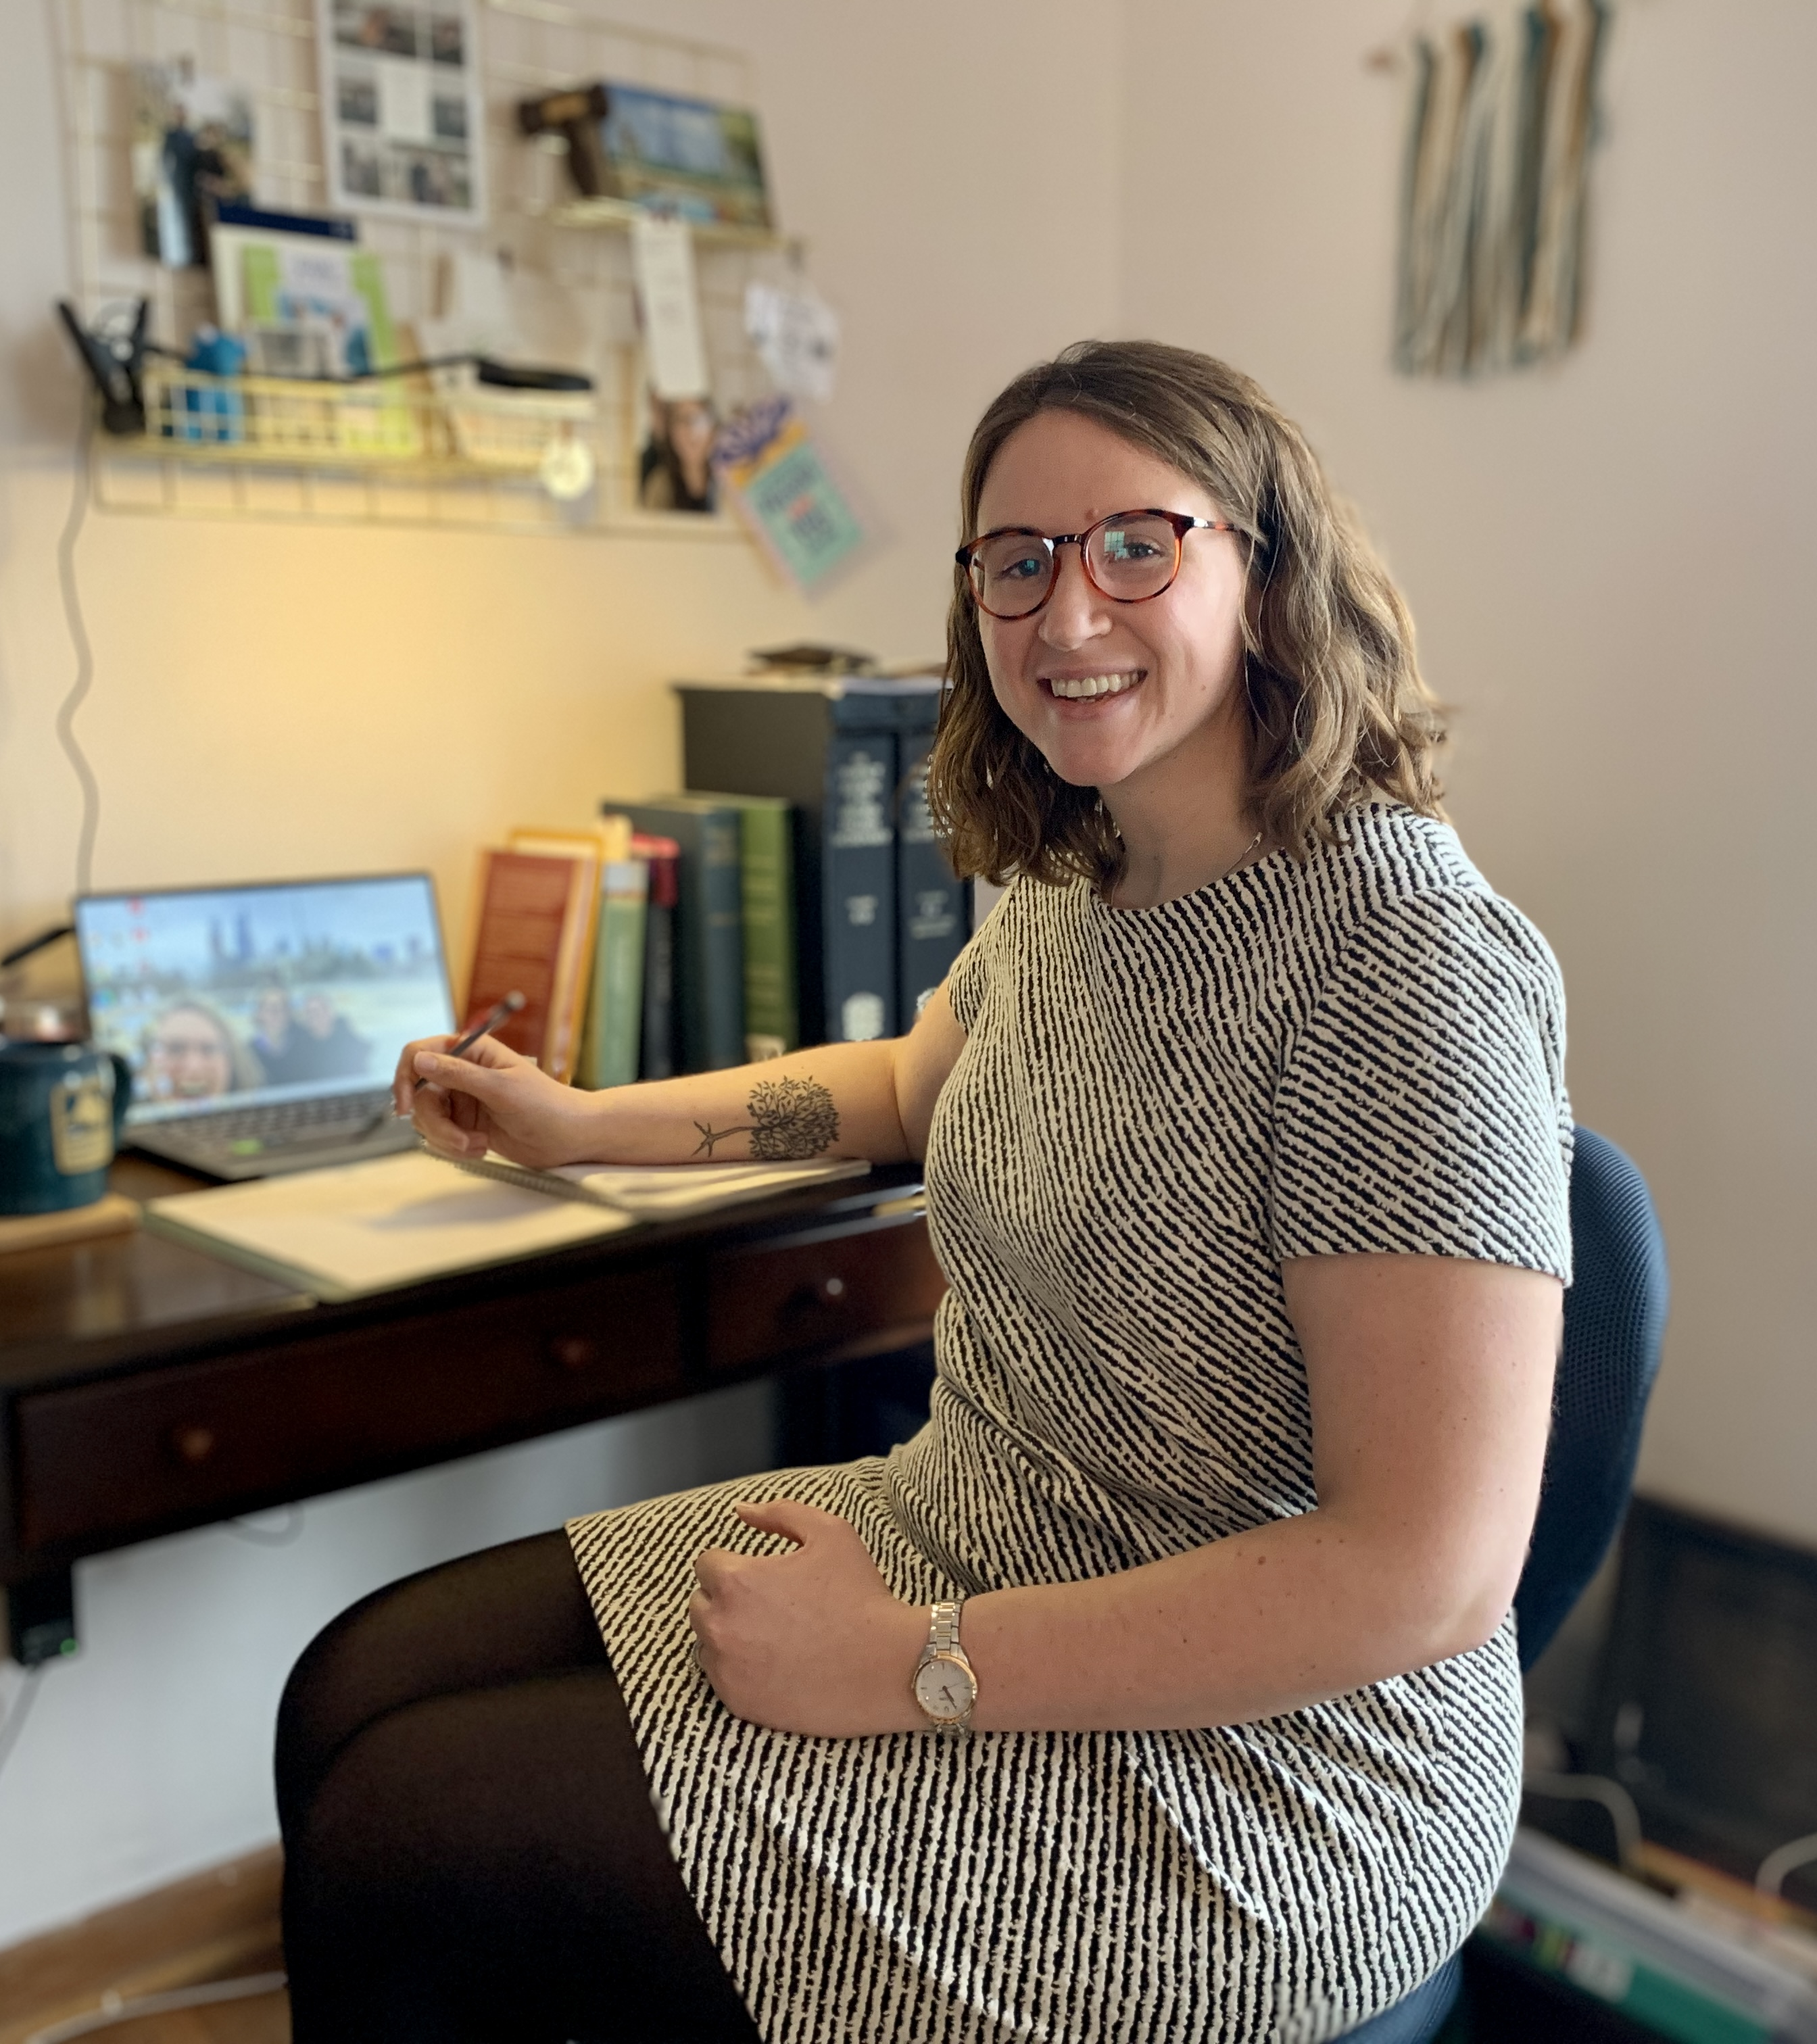
Civil Pro Bono Placements
Center of Elder Law & Justice
ECBA Volunteer Lawyers Program
Journey’s End Refugee Services
Legal Aid of Buffalo
Legal Aid Society of Rochester
Legal Assistance of WNY
Legal Services of WNY
Mental Health Advocate of WNY
Neighborhood Legal Services
Volunteer Legal Services Program (Rochester)
WNY Law Center
Caitlin Beck Rudin ‘20 working remotely for Philadelphia Legal Assistance

Slide 11
Limited Scope Legal Services
Provide short term legal representation
Assist individuals to represent themselves
  Filling out Court forms
  Filing petitions and other Court papers
Technical assistance
Negotiations with landlords in housing cases

Slide 12
Limited Scope Legal Services
Opportunities
Attorney of the Morning in Buffalo City Housing Court (NLS & VLP)
CLARO - consumer debt (WNY Law Center)
Family Court Help Desk (Buffalo, Niagara County)
Pro Se Federal Help Desk (Buffalo & Rochester – Practica, Vice Dean Gargano)
Say Yes Legal Clinics (Buffalo Public Schools & VLP)
Surrogate’s Court Help Desk (CELJ)

Slide 13
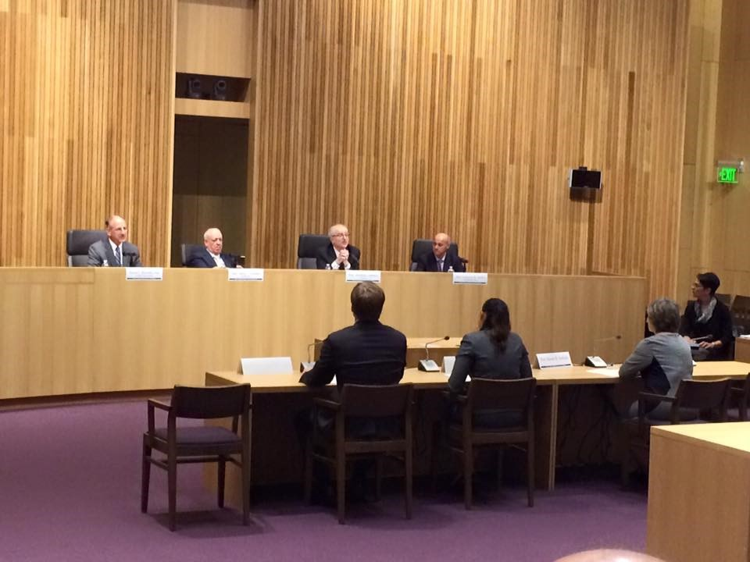
Criminal Pro Bono Placements
Bronx Defenders
District Attorney Offices
Legal Aid Buffalo
Public defender
Appeals
Monroe County Public Defender
Prisoner’s Legal Services
Civil legal services to people who are incarcerated
Jeffrey Donigan ’15 testifying before a Court of Appeals Committee on pro bono services

Slide 14

Contact Info:
Rachel M. Haseley, M.B.A.
Senior HR Manager
rhaseley@elderjusticeny.org
716-853-3087 (238)
Jesslyn A. Holbrook, Esq., M.S.W.
Pro Bono Coordinating Attorney
jholbrook@elderjusticeny.org
716-853-3087 (241)

Slide 15
Center for Elder Law & Justice https://elderjusticeny.org/
Kinship
Guardianship
Consumer Protection
Health Care Advocacy
Long Term Care Ombudsman Program
Elder Abuse Prevention
Housing
Foreclosure Prevention Project
Refugee Services
Community Development
Pooled Trust
MedLaw Partnerships**New
Senior Advice Helpline**New
Surrogate’s Court Help Center** (new)

Slide 16

ECBA Volunteer Lawyers Project
ECBA
Volunteer Lawyers Project
Volunteer Lawyers Project (VLP) provides free civil legal services to low income individuals and small not-for-profits in the greater Western New York region.
GET HELP NOW
https://ecbavlp.com/

Slide 17
ECBA Volunteer Lawyers Project
Bankruptcy & Debt
Divorce
Estate & Wills
Family Law
Immigration
Legal Services for Positive Families and Individuals
Micro-Entrepreneurship Program
Non-Profit Organizations
Tax Foreclosure
Taxpayer Clinics & Representation (LITC)
Tort Defense
Unemployment Benefits

Slide 18
ECBA Volunteer Lawyers Project
Limited Scope Legal Clinics
Family Court Help Desk
Attorney of the Morning (eviction defense)
Housing Helpline (eviction defense)
Pro Se Assistance Program (Federal Court)
Say Yes Legal Clinics (Buffalo Public Schools)
To volunteer contact Maria Valeri at mvaleri@ecbavlp.com or (716) 847-0662 ext. 321

Slide 19
Journey’s End Refugee Services
http://jersbuffalo.org/
U.S. Immigration & Nationality Law
Permanent residence (Green Card) & Citizenship Services
Family Reunification
Travel Documents & Work Authorization
Immigration Status Matters
To volunteer: http://jersbuffalo.org/volunteer

Slide 20

Legal Aid Bureau of Buffalo https://legalaidbuffalo.org/
Foreclosure Prevention
Family Law
Housing
Consumer & Employment
Reentry/Veterans
Attorneys for Children
Education Advocacy Project
Immigrants & Refugees
Criminal Defense
Appeals & Post-Conviction
To volunteer send a letter of interest and resume to resume@legalaidbuffalo.org

Slide 21

Neighborhood Legal Services
http://www.nls.org/
Serves Erie, Niagara, Orleans, Genesee & Wyoming Counties
Offices in Buffalo, Niagara Falls & Batavia
Justice Bus
Contact: https://nls.org/student-volunteers/
Disability
Domestic Violence
Family
Housing
Public Benefits
Social Security & SSI Work Incentives

Slide 22
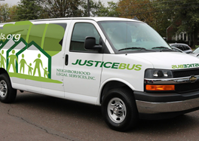

Slide 23
Western New York Law Center http://wnylc.com/
Foreclosure
Class action litigation for low income individuals
  Public assistance applications not processed timely
  Improper repossession of cars
Zombie housing
Community reinvestment by banks

Slide 24
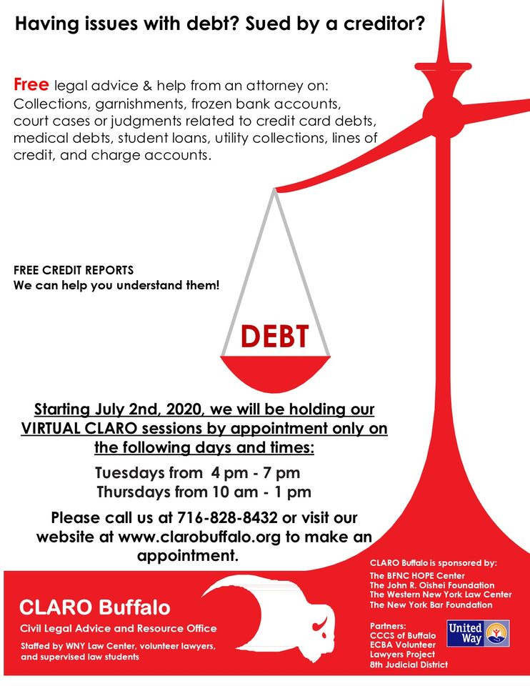
CLARO Buffalo
http://clarobuffalo.org/
Limited advice and counsel sessions to educate unrepresented debtors

Slide 25
Legal Assistance of Western New York
Services:
Consumer
Domestic Violence
Education
Employment
Family
Foreclosure
Health
Housing
Public Benefits
Re-entry
Seniors
Supplemental Security Income
    Office locations:
    Bath
    Elmira
    Geneva
    Ithaca
    Jamestown
    Olean
    Rochester
To volunteer: https://www.lawny.org/Volunteer

Slide 26
Volunteer Legal Services Project of Monroe County
Bankruptcy (Chapter 7) & Debt Collection
Child Custody or Visitation
Town Court (Irondequoit) – Landlord Tenant Program
Child or Spousal Support
Deed Transfers (between relatives or as gifts)
Domestic Violence Divorce and/or Protection
Expungement of record with Child Protective Services
Federal Pro Se Assistance Program
Foreclosure (loss of property due to debt)
Habitat for Humanity Purchases
Immigration Matters
Income Tax Controversies (New York and/or IRS income tax issues)

Slide 27
Volunteer Legal Services Project of Monroe County
Land and/or Contract Disputes
Property Title Issues
Name Changes (including transgender name changes)
Uncontested Estate Administration (when someone has passed away)
Unemployment Insurance Benefit Denials
Standby Guardianship of minor children (for parents with a serious illness)
Tort Defense - for defendants only, sued for personal injury or property damage
Wills, Powers of Attorney, Health Care Proxies (for persons living with serious illnesses (HIV/AIDS, cancer etc.), seniors residing in the City of Rochester, or homeowners residing in the City of Rochester).
For more information, or to volunteer: https://www.vlsprochester.org/studentinterns

Slide 28
For Credit summer pro bono
Clinics
  Contact the Clinic Professor for your preferred Clinic
  Some have fellowships instead
  Email law-clinic@buffalo.edu!
Externships
  Apply online under “Current Students” and “Summer Courses” under “Registrar”
Practica
  Contact the Practica Professor for your preferred

Slide 29


