Slide 1
Let’s Talk Technology
A discussion with Law IT

Slide 2
Law IT/AV Staff and Contacts
Brandon Tubinis
Operations Manager
John Christensen
Systems Administrator
Tedros Teklzghi
Help Desk Manager
Anne Marie Swartz
Audio Visual Department Manager
Offices: (Mon-Fri, 9am to 5pm)
Law Library Service Desk, 221 O'Brian Hall
For Ticketed Law-IT Assistance:
Call 716-645-7393
Email Law-IT-AVServices@buffalo.edu
Submit a request via Law IT's Ticket Support Center
For Live Law-IT Assistance: (Mon-Fri, 9am to 5pm)
Live Zoom Support https://buffalo.zoom.us/j/95845496130
Text 716-222-9905
Chat by adding law.it.live@gmail.com to your University Gmail chat client (using Google Hangouts)

Slide 3
Law IT and the Law IT Webpage
Answer or resolve common questions and requests
  Wi-Fi access
  Email access
  Cloud storage access
  Software download, installation and operation
  Distance learning Zoom, Panopto and UBLearns
Law Lab related issues
  Printing troubleshooting (jams, reprints, reimbursements)
  Computer access and troubleshooting
Provide guidance on how to best proceed with a problem
Visit our webpage for answers and resources https://www.law.buffalo.edu/law-it.html
Ask us anything!

Slide 4
University IT and the UBIT Webpage
UBIT controls many of the broader University-wide services and systems
Visit the UBIT website for answers and resources https://www.buffalo.edu/ubit.html
Software
  Office
  VPN
    Can be used to access licensed databases off campus
Guides, policies and technical documentation
Helpdesk
Alerts pertaining to current security concerns or service outages

Slide 5
School Information Portal (SIP)
Weekly emails pertaining to events and opportunities
Vitally important information pertinent to all law students
No required login to view the messages https://www.law.buffalo.edu/sip

Slide 6
UB Zoom
Claim your Zoom Pro account by logging into https://buffalo.zoom.us with your UB credentials.
Install the client for your computer from the same site
Always join or host meetings from the client software which is logged in with your UB account by clicking SSO
  Certain features of Zoom meetings can only be performed when done through the software.
  Joining meetings from the website: https://buffalo.zoom.us

Slide 7


UB File Systems
University at Buffalo File System (UBFS)
  UB housed file storage
    Default save location when working on any Lab Workstation on campus
  Follows you wherever YOU are logged in
  Can be accessed from personal devices (moderate setup)
  Limited space (256MB)
  Strict privileges
and
  Third party cloud storage
  Follows you wherever YOU are logged in
  Can be accessed from personal devices (easy setup)
  128GB space
  Customizable privileges

Slide 8
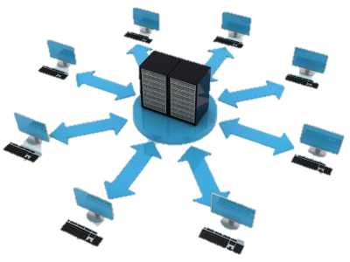
Workstation Hardware Information
All workstations are VDI (Virtual Desktop Infrastructure) devices
  Virtual instance of a computer from a server
  Slow login as each attempt counts as your first
  Quick performance once logged in
  All changes made to computer are reverted at logoff
  Internet dependent (if network is down devices will not function)

Slide 9
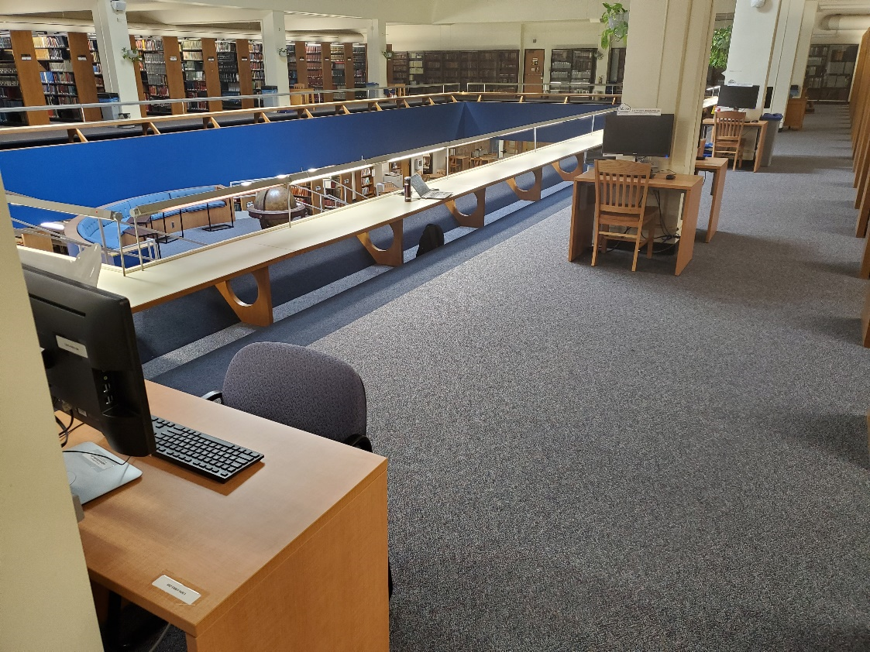
Workstation Identification
Cybrary Workstations
  Universally accessible by any UB student, capable of all the standard functions of a UB Lab Computer
  Five stations located on the 3rd floor, south wall
  Can print to WEPA system

Slide 10
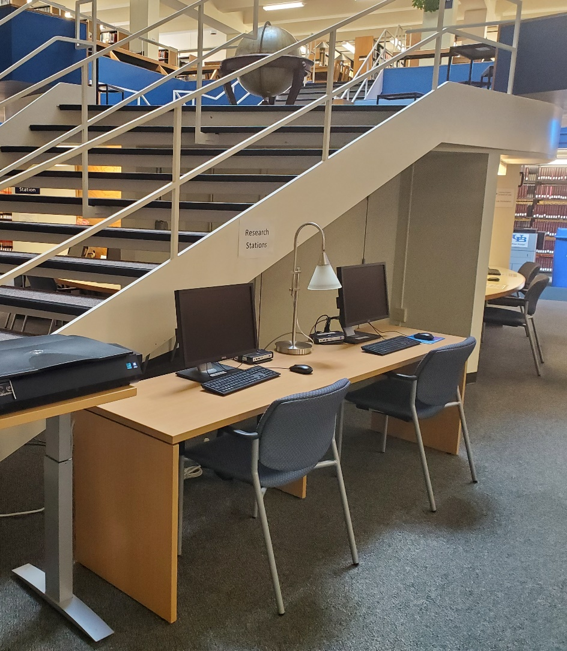
Workstation Identification
Research Workstations
  Universally accessible by any UB student or individuals who are granted access, has no document creation / editing capabilities
  Located throughout the Law Library
    Two located on the 2nd floor, to the right of the stairs
    Two located on the 3rd floor, north wall
  Printing and Office software are not available

Slide 11
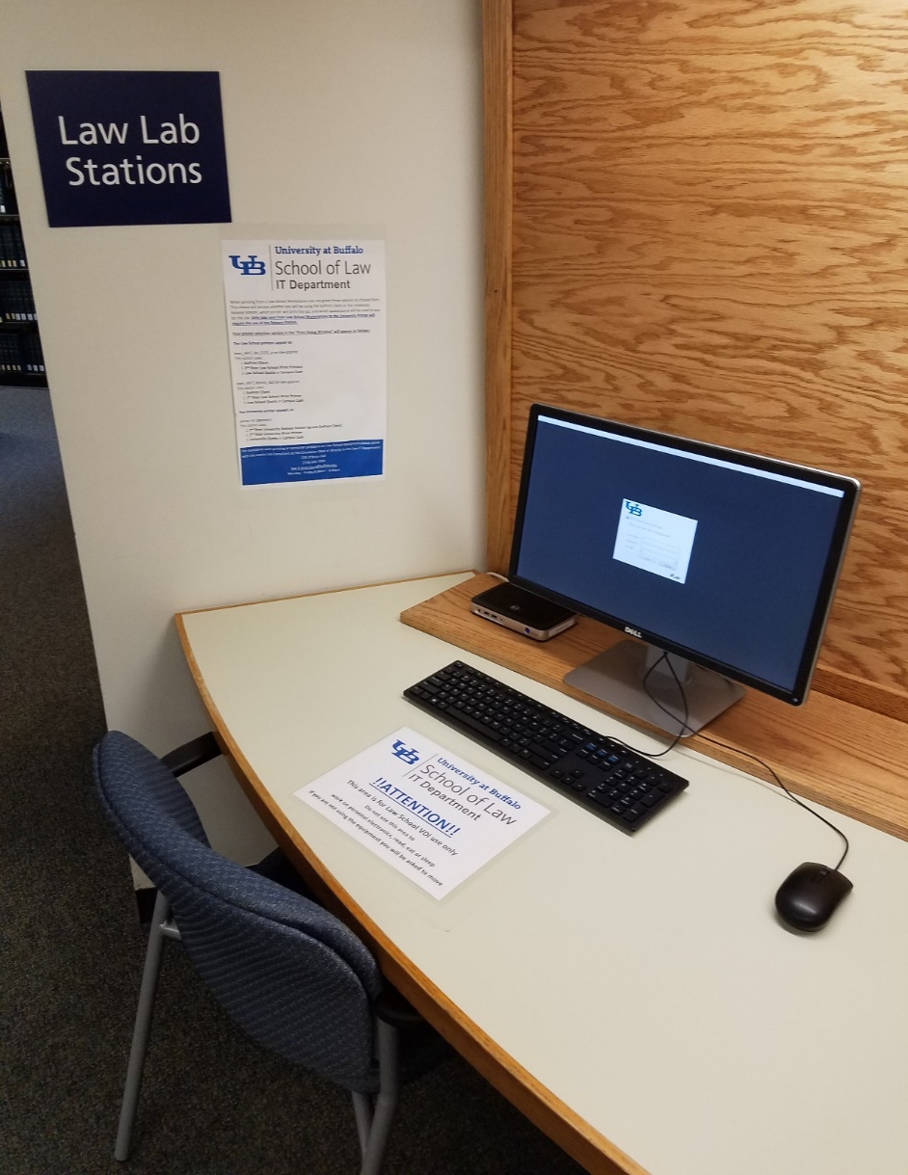
Workstation Identification
Law School Workstations
  Accessible by UB Law students only, capable of all standard functions of a UB Lab Computer
  Located throughout the Law Library
    Ten located on the 2nd floor around stairs
    Five located on the 5th floor
    Six located on the 7th floor
  Can print to WEPA system

Slide 12
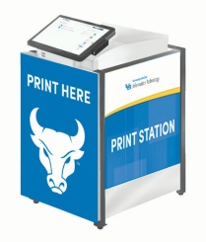
UB Print Anywhere (powered by Wepa)
UB students receive a semesterly quota of pages to print at any of 40 print station kiosks throughout the campus.
  500 pages for Spring and Fall
  200 pages for Summer (if enrolled)
  100 pages for Winter (if enrolled)
  Add more pages through Campus Cash
Two kiosks are located in O’Brian Hall
  1st Floor Lobby
  2nd Floor Outside the Library Entrance
Flexible printing options (mobile device, personal computer, computing site, email, USB)
Information and resources can be found on the UB Print Anywhere site http://www.buffalo.edu/ubit/services/print-anywhere.html

Slide 13
School of Law Mobility Print
UB students receive an annual quota of pages to print on the 2nd and 5th floor of the Law Library.
  500 pages per year
Print from your personal computer only
Information and resources can be found on the School of Law Mobility Print site https://mobilityprint.law.buffalo.edu/

Slide 14
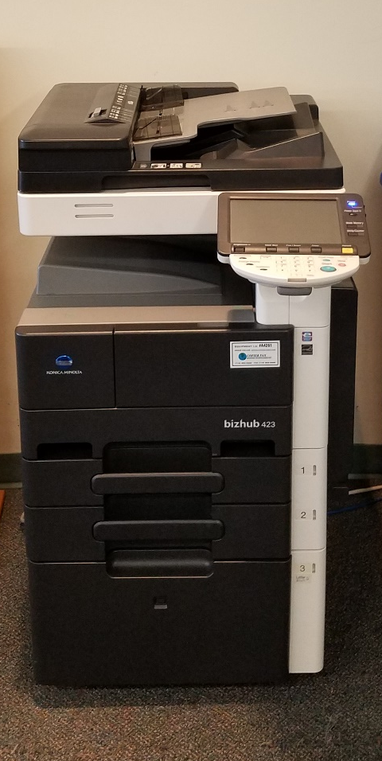
Scanning on 5th Floor
The printer on the 5th floor is capable of scanning single and multi-page documents. Scan custom sizes for books or non-standard documents.
Book scan and single scans can be cumbersome, these types of scans are best suited to the scan stations on the 2nd or 5th floor.
Requires a valid email address
Defaulted file type is PDF
Directions are available at the printer itself and online
Cannot make copies

Slide 15
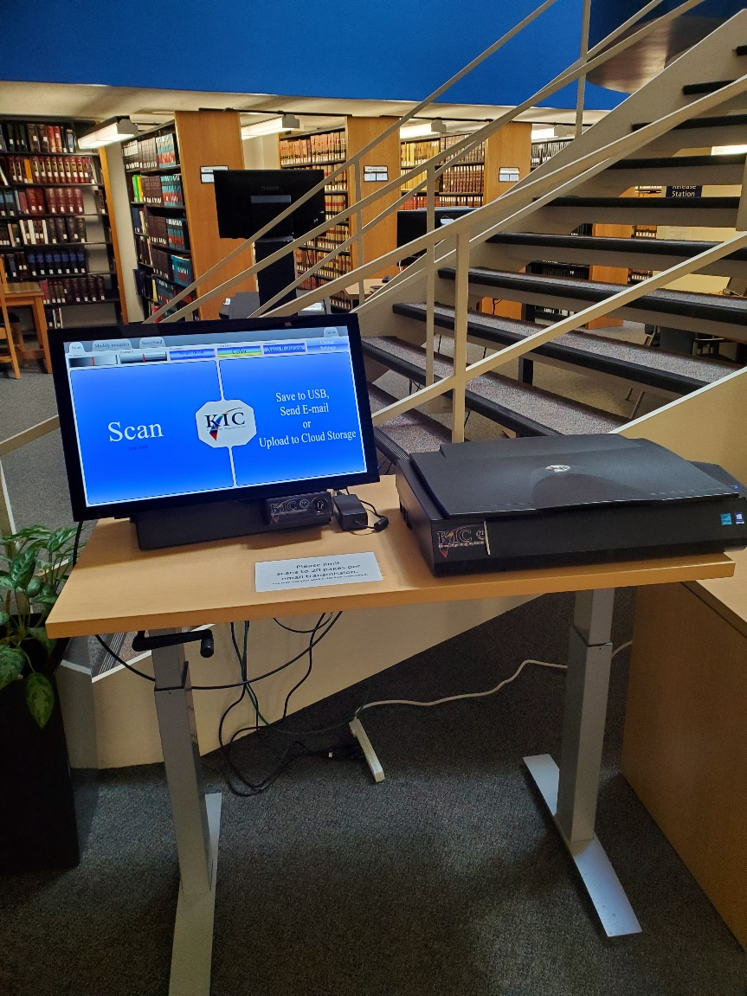
Scanning on Scan Stations
Scan Stations on the 2nd floor are capable of scanning single page documents. Can scan custom sizes for books or non-legal documents very easily.
Multiple outputs
  Scan to email, USB, barcode, cloud
  Can scan as many file extensions
Cannot make copies

Slide 16
Exams using Examplify
Examplify is an exam delivery software licensed by ExamSoft Worldwide Inc. The program serves as a simplified word processor that enables students to take an examination on a laptop computer. Examplify provides instructors the ability to lock down all Windows applications thereby providing exam security.
If you are taking an exam through Examplify, you are expected to provide your own Examplify capable device.
Information and resources can be found on the Law School Records and Registration site: https://www.law.buffalo.edu/registrar/exam-policies-procedures/taking-exams/examplify-information.html

Slide 17
Topics to review
Where to Find IT Resources
Visit Law IT website https://www.law.buffalo.edu/law-it.html
Visit UBIT website http://www.buffalo.edu/ubit.html
Alerts
Security – phishing
Software
Zoom Best Practices
Claim your account https://buffalo.zoom.us
Always login to Zoom
Requirements
Printing
UB Print Anywhere https://www.buffalo.edu/ubit/services/print-anywhere.html
Law Mobility Print https://mobilityprint.law.buffalo.edu/
Lab
https://law.lib.buffalo.edu/use/computers-scanners/
Wipe before you use!
Exams
Examplify Download Link – https://examsoft.com/buffalolaw

